Slide 1
Traffic signs classification
DSc Lab Project
Group 23

Slide 2
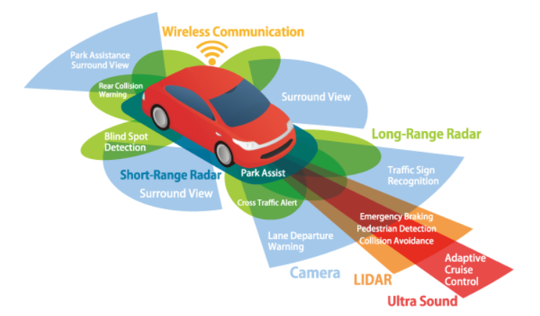
Introduction

Slide 3
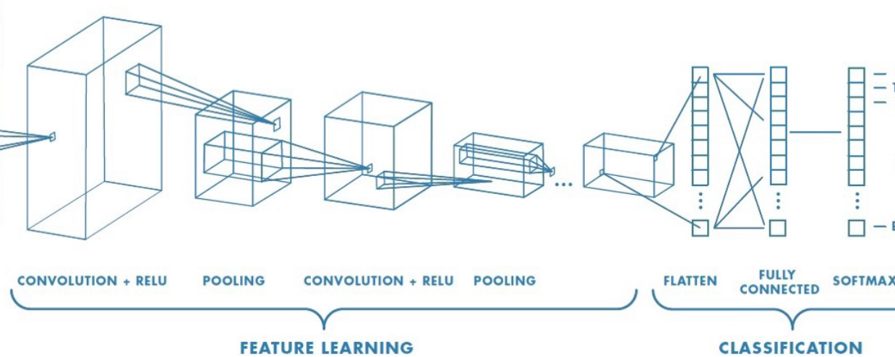

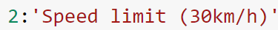

Slide 4

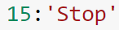

Slide 5
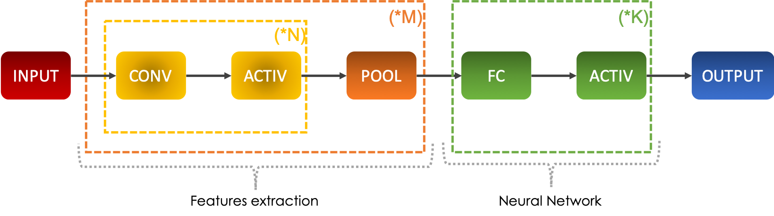
ConvNets

Slide 6
ConvNets
Computer vision is a part of deep learning which can deal with images on very large scales.
It allows the computer to process and understand the content of a large number of pictures.
The main architecture of computer vision is the convolutional neural networks which is a derivative of feed-forward neural networks.
Very wide applications such as image classification, object detection, face detection, etc.

Slide 7
A convolutional neural network is a series of convolutional and pooling layers which allow extracting the main features from the images.
Convolution block consists of a convolution and a pooling layer.
Convolutional layer applies the filter on the input 2D pixelated image.
Pooling(Usually max-pooling) then extracts the main features from the convolved layer.
ConvNets

Slide 8
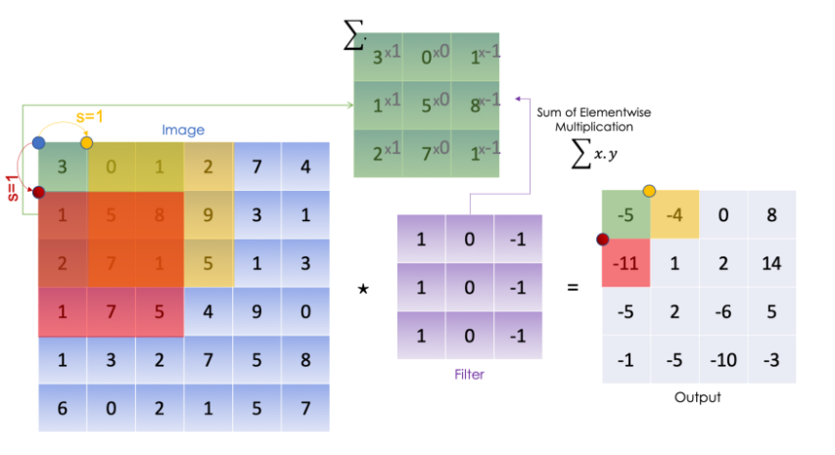
ConvNet visuals
(Convolving)

Slide 9

ConvNet visuals
(Max-Pooling)

Slide 10
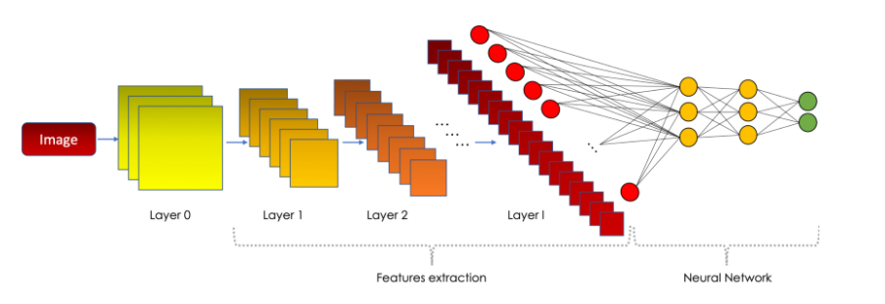
Now since we have our extracted features, we finally flatten it and feed it to the fully connected network.
This network then finally classifies the input images.
Visual of ConvNets

Slide 11
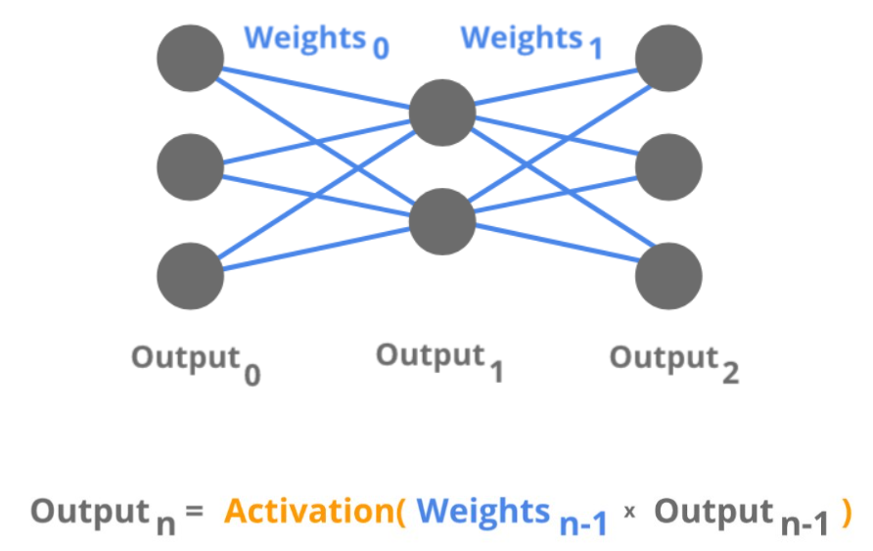

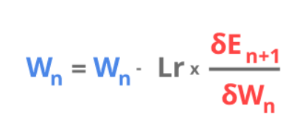
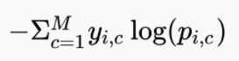
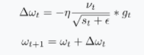

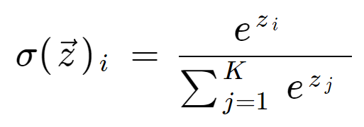
Forward Propagation
Backward Propagation
Loss function-Categorical Cross Entropy
Adam Optimizer
Activation Functions
Rectified Linear Unit(ReLu)
Softmax
Maths Concepts/ Formulas

Slide 12
Our implementation
We used a dataset, which contains around 43 classes of traffic sign images.
2 convolutional blocks:
1st block:
32 units in conv layer : 3x3 kernel size
Max-pooling layer: 2x2
2nd block:
64 units in conv layer: 3x3 kernel size
Max-pooling layer: 2x2

Slide 13
Our implementation
Flatten layer
2 dense layers:
1st layer: 256 units
2nd layer: 43 units (For output)
Other parameters:
Loss: categorical cross entropy
Optimizer: Adam
Metric: Accuracy

Slide 14
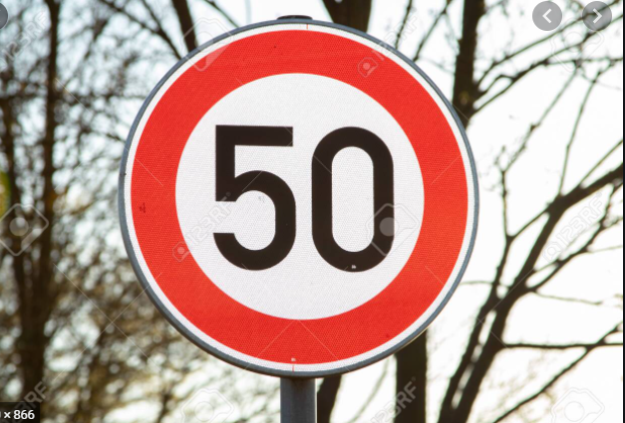
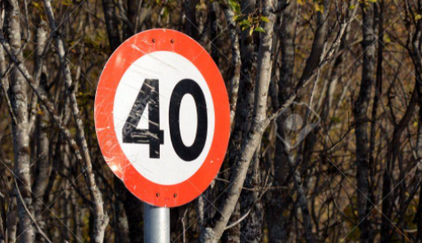
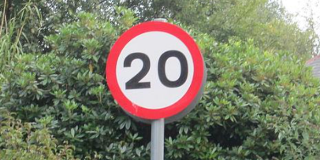
Our task is to develop a model which can classify traffic road signs such as...
Speed Limit
Approach/ Python3 Code Implementation

Slide 15
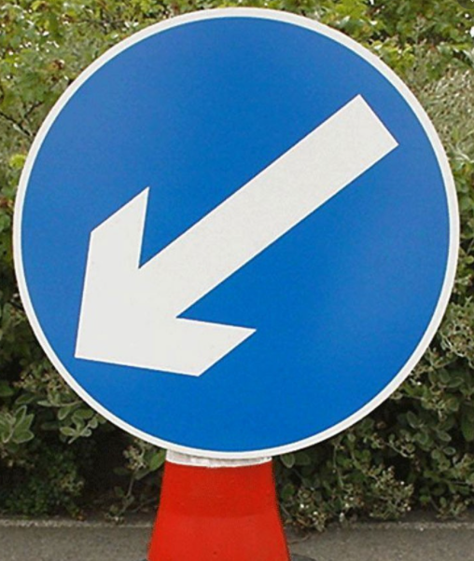

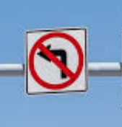
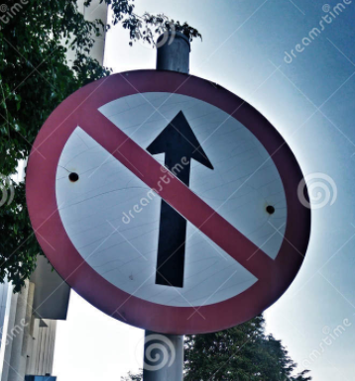
Directional Signs

Slide 16
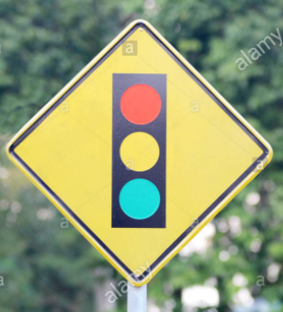

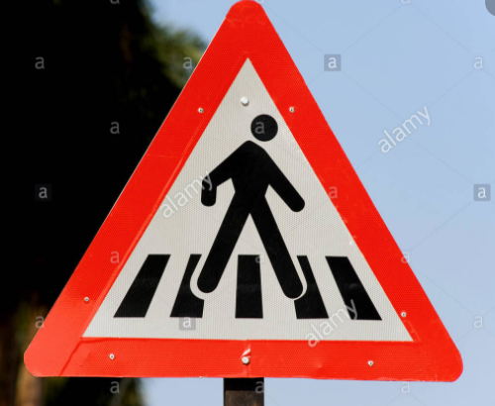
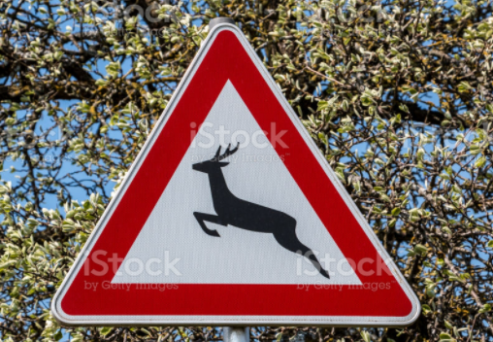
Traffic Events

Slide 17


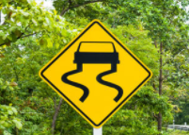
and Warning Signs

Slide 18
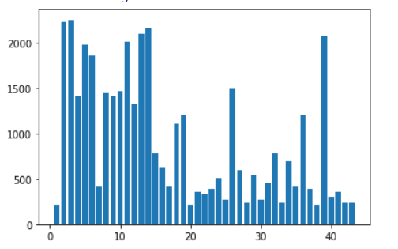
… totalling up to 39,209 road traffic signs over 43 classes
which were imported and are distributed as follows
Notes:
Add xlabel, ylabel and plt.title
Colorize the graph bars

Slide 19
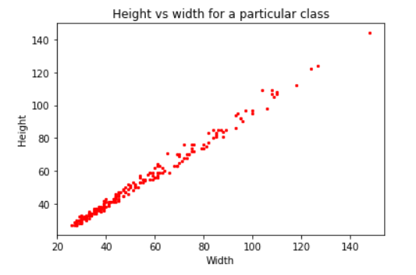
… with the images within each class of traffic signs
having a wide-variety of sizes

Slide 20
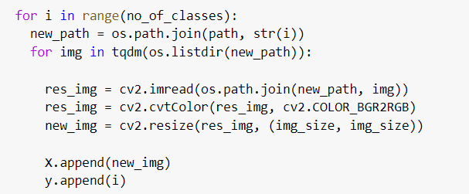
Each image is converted into a list of pixels in BGR format
which is rightfully converted into
RGB and resized into an image of size
30pixels x 30pixels

Slide 21
This is followed by
Shuffling the feature and target vectors
One hot encoding of the target vector
Splitting of the feature vector into
Training Set
Validation Set

Slide 22
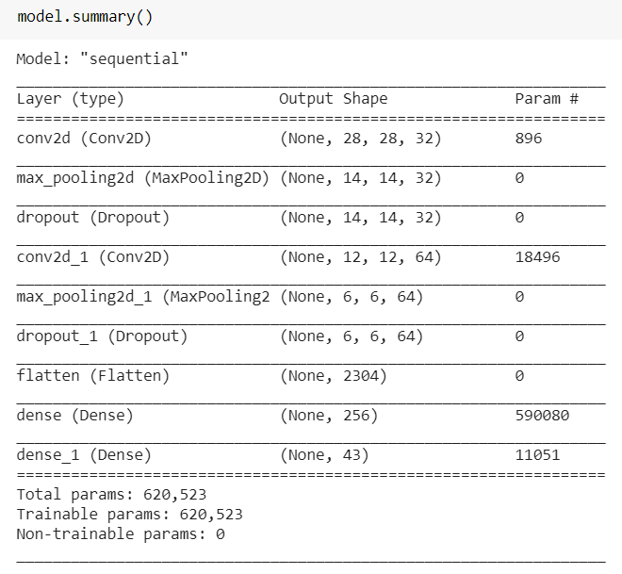
SEQUENTIAL CNN MODEL
Layer-wise
SUMMARY

Slide 23
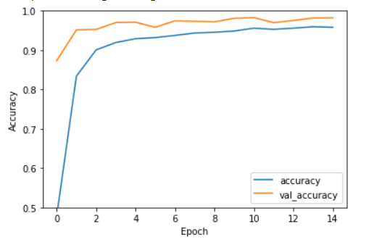
SEQUENTIAL CNN MODEL
Accuracy Scores for Training Set
And
Validation Set
against each epoch

Slide 24
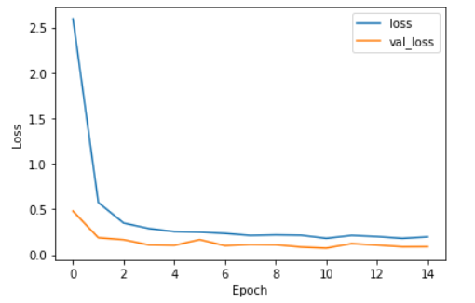
SEQUENTIAL CNN MODEL
Loss for
Training Set
And
Validation Set
against each epoch

Slide 25
Conclusion
The convolution neural network built classifies the traffic sign images with an accuracy of approximately 92%, and can be used in real world applications as a part of self driving cars, etc.

Slide 26


